Slide 1
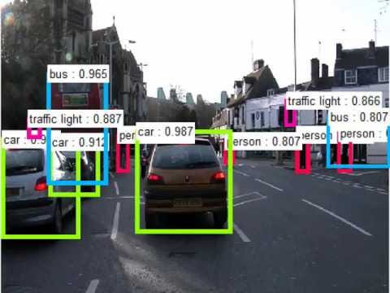
Object Detection for Self-Driving Car Game

Slide 2
Group Members
Bhaviya Chopra (TL)
Gagandeep Singh
Favour Eseagwu
Ashwin Philip
Mohammedfaiq Shaikh

Slide 3
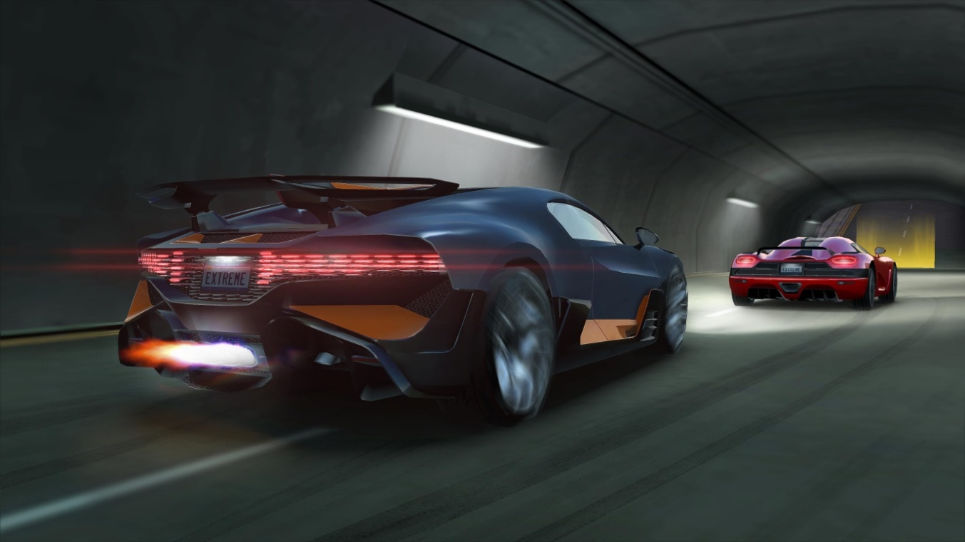
Work Done
Data Collection
Data Preprocessing
Data Augmentation
Model Training
Evaluation

Slide 4
Data Loading and Exploration:
Import necessary libraries: numpy, pandas, sklearn, matplotlib, and PIL.
Load the dataset containing image labels from a CSV file using Pandas.
Shuffle the dataset to ensure randomness.
Display the first few rows of the dataset to understand its structure.
Extract unique class IDs from the dataset.

Slide 5
Visualization of Ground Truth:
Define class labels and a dictionary to map class IDs to class names.
Install the Pillow library for image manipulation.
Load images and bounding box coordinates for each class ID.
Visualize each class's bounding boxes on their corresponding images using Matplotlib.

Slide 6
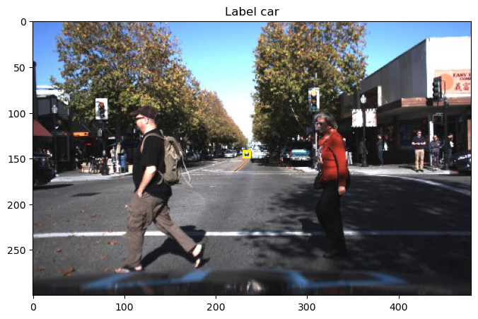

Slide 7
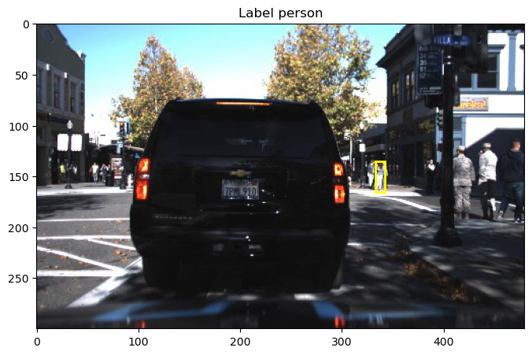

Slide 8
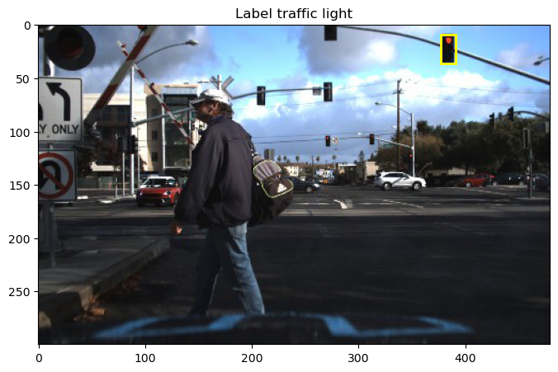

Slide 9
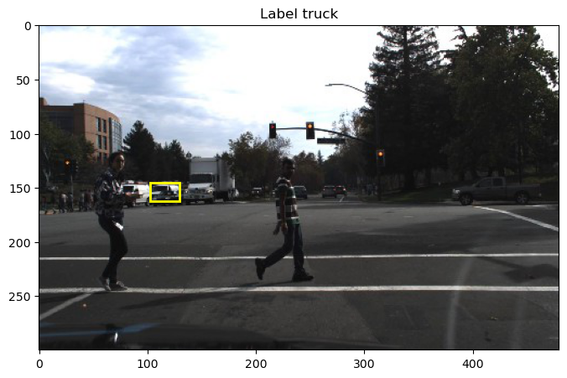

Slide 10
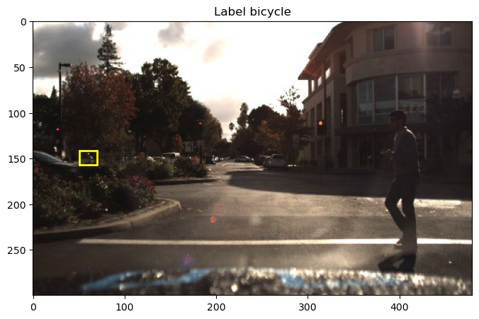

Slide 11
Installing Ultralytics and YOLO:
Install the Ultralytics library, which includes YOLO implementations.
Import necessary classes and libraries (YOLO, PIL, Image, display, os, pathlib).
Initializing YOLO Model:
Initialize a YOLO model (YOLO("yolov8m.pt")) for object detection.

Slide 12
Object Detection on Images:
Perform object detection on an image using the initialized model.
Set confidence and IoU (Intersection over Union) thresholds.
Retrieve and print the detected objects' class, coordinates, and probability.

Slide 13

Iterating Over Results:
Loop through all the detected objects and print their details.
Print the class, coordinates, and probability for each object.

Slide 14
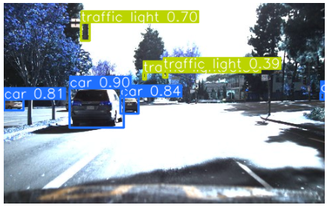
Performing Object Detection on Another Image:
Repeat the object detection process on another image.
Plot the results using the plot() function provided by the Ultralytics library.
Convert the plot to a PIL Image and display it.

Slide 15
CONCLUSION
Object detection is a fundamental task in various applications, including self-driving car scenarios.
The YOLO algorithm provides an efficient way to detect multiple objects within an image.
By understanding and implementing the code, we can gain insights into how to perform object detection using YOLO for a self-driving car game's image data.
This knowledge can be extended to real-world scenarios, such as autonomous driving systems, surveillance, and more.

Slide 16


